Slide 1

A Hybrid MLP-SVM Model for Classification using Spatial-Spectrum Features on Hyper-spectral Images
Presented By: Group No. 10
Department of Computer Engineering

Slide 2
Table of Content
Introduction
Materials and Methods
Proposed Work
Experimental Results
Internal Working of Machine Learning
Conclusion
References

Slide 3
Introduction
Remote sensing alludes to the process of acquisition of valuable information about distant.
It plays an important role in various fields like mapping of used land, environmental study, forecasting the weather and weather reports, study including natural hazards and exploration of resource.
Land Cover Classification is the one we are focused on in this current work.

Slide 4
Material and Methods
In proposed method, experiments will conducted on Indian Pines, U. Pavia and Salinas dataset.
SVM is a class of machine learning algorithms that works by finding a (n-1)-dimensional hyper-plane that correctly classifies data points.
MLP, it is basically a combination of different layers of perceptron stacked together i.e. the output of first layer is used as input for the second layer and so on.

Slide 5
Proposed Work
Patching Concept
Band Adaptive Spectral-Spatial Features
Hybrid Classifier MLP-SVM
Parameter Tuning – C and Gamma in SVM
Pixel-wise Classification
Prediction on region without Ground Truth
Tested proposed model on diverse dataset such as Indian Pines, U. Palvia and Salinas.

Slide 6
In the proposed method, we worked on pixel wise classification with patch size one using hybrid classifier MLP-SVM.
MLP
SVM
Replace
Input Patch
Fully Connected_1
Fully Connected_2
Fully Connected_3
Output Layer
Classifier (SVM)
Class Probabilities
Class Prediction
N*N, F 500 350 250 16
*N denotes input patch, Here N=1 and F is no. of Features
Fig. Represents the proposed hybrid MLP-SVM based model for classification.

Slide 7
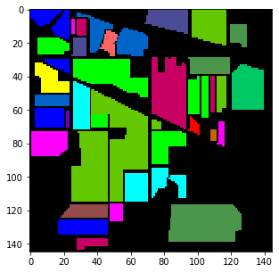
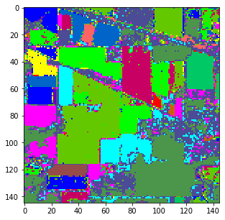
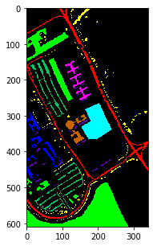
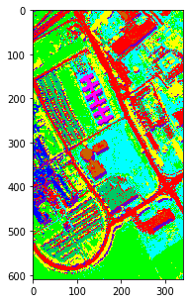
Results and Discussion
(a)
(b)
(c)
(d)
Fig. Represents the Indian Pines, U. Palvia dataset (a), (c) Ground Truth , (b), (d) Output from proposed model with region without ground truth.

Slide 8
Table. Represents the evaluation metrics based on hybrid classifier on Indian Pines.
 | Precision% | Recall% | F-score% | Accuracy%
MLP-SVM | 92.25 | 93.75 | 92.88 | 93.22
MLP-KNN | 88.06 | 88.13 | 87.75 | 90.83
MLP-RF | 93.13 | 91.81 | 92.31 | 91.41
MLP-DT | 86.31 | 86.75 | 86.31 | 86.24
SVM | 87.50 | 89.25 | 87.19 | 86.97
KNN | 76.56 | 78.50 | 76.18 | 76.92
RF | 83.13 | 79.06 | 80.75 | 86.34
DT | 70.81 | 69.00 | 69.50 | 74.10
MLP | 86.06 | 84.56 | 85.13 | 91.61

Slide 9
Table. Represents the evaluation metrics based on hybrid classifier on U. Palvia.
 | Precision% | Recall% | F-score% | Accuracy%
MLP-SVM | 96.22 | 95.67 | 96.22 | 96.87
MLP-KNN | 95.00 | 94.55 | 94.67 | 95.82
MLP-RF | 95.89 | 94.78 | 95.11 | 96.39
MLP-DT | 92.56 | 92.33 | 92.44 | 93.81
SVM | 81.22 | 78.11 | 79.00 | 88.58
KNN | 91.66 | 89.56 | 90.44 | 91.22
RF | 93.00 | 90.44 | 91.56 | 92.85
DT | 87.00 | 87.33 | 87.33 | 88.95
MLP | 95.11 | 95.22 | 95.22 | 96.20

Slide 10
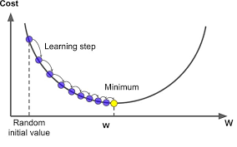
Working of gradient decent Algorithm
Algorithm:
Repeat until converge
{
w[j]=w[j]-L_rate*derivative(J(W))
}
Fig. Represents the working of Gradient Descent Algorithm.

Slide 11
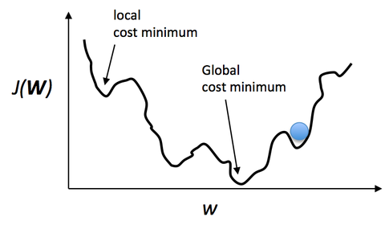
Problem in Gradient Descent
Fig. Represents the Local and Global minima

Slide 12
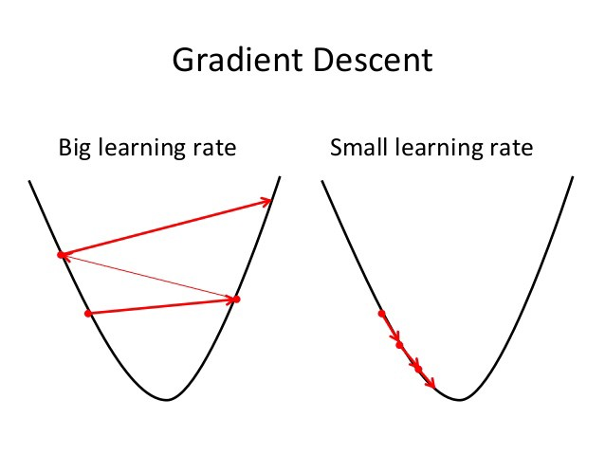
Importance of Learning Rate
If L_rate is large then it may increase error instead of decreasing as below:Fig1.1
If L_rate(alpha) is small then it will take long time to train a network:Fig1.2
Fig. Represents the how the learning rate affect the working of Gradient Descent.

Slide 13
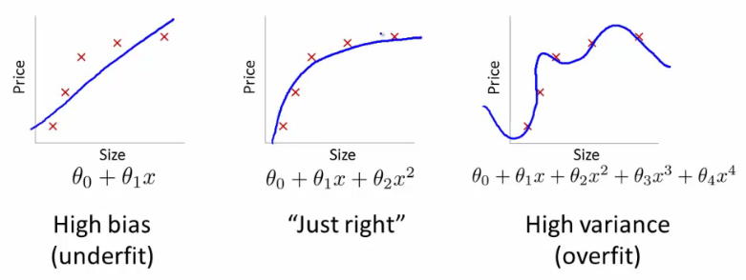
Problem of Under-fit and Over-fit
Fig. Represents under fit, just-fit and over fit.

Slide 14
Solution to Under-fit and Over-fit
1) Underfit :Increase the Number of Feature
2) Overfit:
Reduce the number of features:
Manually select which features to keep.
Use a model selection algorithm (studied later in the course).
3) Regularization
Keep all the features, but reduce the magnitude of parameters θ
Regularization works well when we have a lot of slightly useful features.

Slide 15
Regularization
Y= θ₀ + θ₁X+ θ₂X²+ θ₃X³
J(θ)=1/(2*m)[ ∑ (H(X)-Y)² + λ ∑ θ² ]
θ=θ(1-α*λ/m)- α/m∑(H(x)-Y)*X
If λ is very large then -> θ*very small value -> θ >0
Hence ,Y= θ₀ because θ₁=0 approx. and remaining θ values
If λ is very small or 0 then Problem of regularization is remain unsolved because it donot reduce high degree polynomial which cause overfitting
Hence we have to take Intermediate value of λ

Slide 16
Conclusion
In the proposed model, we worked on hybridization of MLP-SVM. We used three hidden layers with neurons as 500, 350 and 250 respectively. Output of final hidden layer is used as input to the SVM for classification into different classes.

Slide 17
References
Bisht, B. S., & Kothyari, B. P. (2001). Land-cover change analysis of Garur Ganga watershed using GIS/remote sensing technique. Journal of the Indian Society of Remote Sensing, 29(3), 137-1414.
Müller, D., Kuemmerle, T., Rusu, M., & Griffiths, P. (2009). Lost in transition: determinants of post-socialist cropland abandonment in Romania. Journal of Land Use Science, 4(1-2), 109-129.
Prakasam, C. (2010). Land use and land cover change detection through remote sensing approach: A case study of Kodaikanal taluk, Tamil nadu. International journal of Geomatics and Geosciences, 1(2), 150.

Slide 18

Thanks

